Slide 1
AZ-400.00 Module 20: Optimize feedback mechanisms

Slide 2
Lesson 01: Module overview

Slide 3
Module overview
Lesson 5: Analyze alerts to establish a baseline
Lesson 1: Module overview
Lesson 6: Blameless retrospectives and a just culture
Lesson 2: Site Reliability Engineering
Lesson 3: Analyze telemetry to establish a baseline
Lesson 7: Module review and takeaways
Lesson 4: Perform ongoing tuning to reduce meaningless or non-actionable alerts

Slide 4
Learning objectives
After completing this module, students will be able to:
Analyze alerts to establish a baseline
Analyze telemetry to establish a baseline
Perform live site reviews and capture feedback for system outages
Perform ongoing tuning to reduce meaningless or non-actionable alerts

Slide 5
Lesson 02: Site Reliability Engineering

Slide 6

What is site reliability engineering?
Site Reliability Engineering (SRE) empowers software developers to own the ongoing daily operation of their applications in production

Slide 7

Lesson 03: Analyze telemetry to establish a baseline

Slide 8

When would I get a notification?
Application Insights automatically analyzes the performance of your web application and can warn you about potential problems

Slide 9
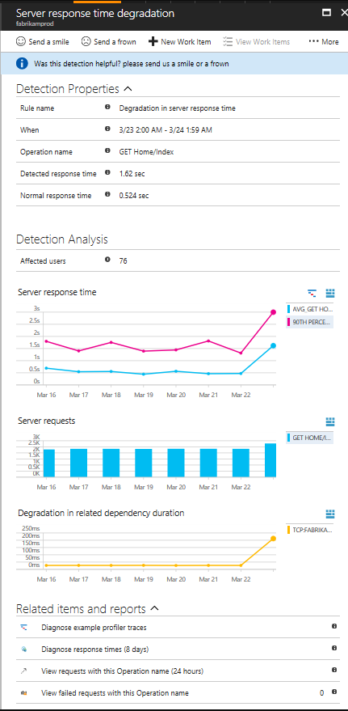
How do I fix it?
Triage
Scope
Diagnose

Slide 10
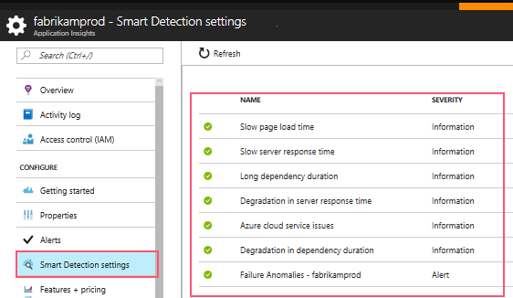
Configure email notifications

Slide 11
How can I improve performance?
1
Triage
2
Diagnose slow page loads
3
Improve slow pages

Slide 12
Server Response Time Degradation
Response time compared to normal response time
Number of affected users
Average response time
Count of this operation requests on the day of detection and 7 days before
Correlation between degradation in this operation and degradations in related dependencies
Links to help diagnose the problem

Slide 13
Lesson 04: Perform ongoing tuning to reduce meaningless or non-actionable alerts

Slide 14

Monitoring and alerting
Monitoring and alerting enables a system to tell us when it’s broken, or perhaps to tell us what’s about to break

Slide 15
Monitor for your users
Basic availability and correctness
Latency
Completeness/freshness/durability
Only temporary outages
Features

Slide 16

Lesson 05: Analyze alerts to establish a baseline

Slide 17

What are alerts in Microsoft Azure
Alerts proactively notify you when important conditions are found in your monitoring data

Slide 18
What you can alert on
Metric values
Log search queries
Activity Log events
Health of the underlying Azure platform
Tests for web site availability

Slide 19
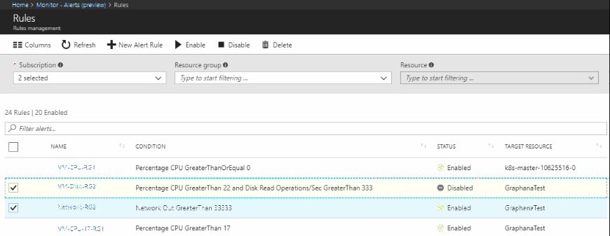
Manage alert rules

Slide 20
Lesson 06: Blameless retrospectives and a just culture

Slide 21
Discussion
What does it mean to have a blameless Retrospective?
Discuss a blameless retrospective

Slide 22
Lesson 07: Module review and takeaways

Slide 23
What did you learn?
Analyze alerts to establish a baseline
Analyze telemetry to establish a baseline
Perform live site reviews and capture feedback for system outages
Perform ongoing tuning to reduce meaningless or non-actionable alerts

Slide 24
Module review questions
1
True or False: Application Insights analyzes the traffic from your website against historic trends and sends you smart detection notifications on degradation
Notes:
Q1 Answer: True

